Slide 1
HUMAN GROWTH AND DEVELOPMENT
Adolescent Assessment
تقييم المراهق (Adolescent Assessment)
Human Growth and Development · Practical Lectures
Source document: Chapter 8 — Adolescent Assessment.pdf
7 pages · Nursing Lectures · Level 26–27
Notes:
Title slide generated from Chapter 8 — Adolescent Assessment.pdf (7 pages). Source text is reproduced verbatim in the notes of every content slide.

Slide 2
HUMAN GROWTH AND DEVELOPMENT
Chapter Overview & Objectives
Scope of this chapter
Health promotion of the adolescent and family: growth during puberty, sexual maturation, nutrition needs, body image and eating disorders, injury prevention, immunization and special screens, and psychosocial assessment.
Learning outcomes — the document's own sections
• 8.1 Site Profile — Adolescent Health Supervision (p. 1)
• 8.2 Physical Growth During Puberty (p. 2)
• 8.3 Sexual Maturation — Tanner Staging (p. 3)
• 8.4 Nutrition in Adolescence (p. 4)
• 8.5 Body Image & Eating Disorders (p. 4)
• 8.6 Injury Prevention & Safety (p. 5)
• 8.7 Adolescent Immunizations & Special Screens (p. 5)
• 8.8 Psychosocial Assessment & Health Education (p. 6)
Adolescent Assessment
1
Notes:
Overview assembled verbatim from page 1 and the numbered headings of Chapter 8 — Adolescent Assessment.pdf.

Slide 3
HUMAN GROWTH AND DEVELOPMENT
Contents
8.1 8.1 Site Profile — Adolescent Health Supervision — p. 1
8.2 8.2 Physical Growth During Puberty — p. 2
8.3 8.3 Sexual Maturation — Tanner Staging — p. 3
8.4 8.4 Nutrition in Adolescence — p. 4
8.5 8.5 Body Image & Eating Disorders — p. 4
8.6 8.6 Injury Prevention & Safety — p. 5
8.7 8.7 Adolescent Immunizations & Special Screens — p. 5
8.8 8.8 Psychosocial Assessment & Health Education — p. 6
Adolescent Assessment
2
Notes:
Section headings exactly as numbered in the source document.

Slide 4
HUMAN GROWTH AND DEVELOPMENT
8.1 Site Profile — Adolescent Health Supervision
Source page 1 of 7
ROTATION: ADOLESCENT ASSESSMENT
Chapter 8 — Adolescent Assessment (12-20 years)
Health promotion of the adolescent and family: growth during puberty, sexual maturation,
nutrition needs, body image and eating disorders, injury prevention, immunization and special
screens, and psychosocial assessment.
Age range: 12 – 20 years
The AAP, American Academy of Family Physicians, American Medical Association, and the U.S.
Preventive Services Task Force publish similar guidelines for health supervision of adolescents;
services must meet physical and emotional needs and are best delivered by providers trained in
adolescent care.
BRIGHT FUTURES — ISSUES TO ADDRESS AT EVERY ADOLESCENT HEALTH VISIT
Adolescent Assessment
3
Notes:
ROTATION: ADOLESCENT ASSESSMENT
Chapter 8 — Adolescent Assessment (12-20 years)
Health promotion of the adolescent and family: growth during puberty, sexual maturation,
nutrition needs, body image and eating disorders, injury prevention, immunization and special
screens, and psychosocial assessment.
Age range: 12 – 20 years
8.1 Site Profile — Adolescent Health Supervision
The AAP, American Academy of Family Physicians, American Medical Association, and the U.S.
Preventive Services Task Force publish similar guidelines for health supervision of adolescents;
services must meet physical and emotional needs and are best delivered by providers trained in
adolescent care.
BRIGHT FUTURES — ISSUES TO ADDRESS AT EVERY ADOLESCENT HEALTH VISIT
Physical growth and development — physical and dental health, body image, healthy nutrition,
physical activity.
Social and academic competence — relationships with peers and family, school performance,
interpersonal relationships.
Emotional well-being — mental health and sexuality.
Risk reduction — tobacco, alcohol, other drugs, pregnancy, sexually transmitted infections.
Violence and injury prevention.
CONFIDENTIALITY
The availability of confidential services is particularly important for adolescents; most states have
provisions for confidential care, and laws vary by state. Establish the age-related policy for your
clinical setting before the interview and explain it to the adolescent and family.

Slide 5
HUMAN GROWTH AND DEVELOPMENT
8.1 Site Profile — Adolescent Health Supervision
Source page 1 of 7 (continued)
Physical growth and development — physical and dental health, body image, healthy nutrition,
physical activity.
Social and academic competence — relationships with peers and family, school performance,
interpersonal relationships.
Emotional well-being — mental health and sexuality.
Risk reduction — tobacco, alcohol, other drugs, pregnancy, sexually transmitted infections.
Violence and injury prevention.
CONFIDENTIALITY
The availability of confidential services is particularly important for adolescents; most states have
provisions for confidential care, and laws vary by state. Establish the age-related policy for your
clinical setting before the interview and explain it to the adolescent and family.
Adolescent Assessment
4
Notes:
ROTATION: ADOLESCENT ASSESSMENT
Chapter 8 — Adolescent Assessment (12-20 years)
Health promotion of the adolescent and family: growth during puberty, sexual maturation,
nutrition needs, body image and eating disorders, injury prevention, immunization and special
screens, and psychosocial assessment.
Age range: 12 – 20 years
8.1 Site Profile — Adolescent Health Supervision
The AAP, American Academy of Family Physicians, American Medical Association, and the U.S.
Preventive Services Task Force publish similar guidelines for health supervision of adolescents;
services must meet physical and emotional needs and are best delivered by providers trained in
adolescent care.
BRIGHT FUTURES — ISSUES TO ADDRESS AT EVERY ADOLESCENT HEALTH VISIT
Physical growth and development — physical and dental health, body image, healthy nutrition,
physical activity.
Social and academic competence — relationships with peers and family, school performance,
interpersonal relationships.
Emotional well-being — mental health and sexuality.
Risk reduction — tobacco, alcohol, other drugs, pregnancy, sexually transmitted infections.
Violence and injury prevention.
CONFIDENTIALITY
The availability of confidential services is particularly important for adolescents; most states have
provisions for confidential care, and laws vary by state. Establish the age-related policy for your
clinical setting before the interview and explain it to the adolescent and family.

Slide 6
HUMAN GROWTH AND DEVELOPMENT
8.2 Physical Growth During Puberty
Source page 2 of 7
The final 20% to 25% of linear growth is achieved during puberty, and up to 50% of ideal adult
body weight is gained during this time.
Girls begin puberty and reach maturity about 1½ to 2 years earlier than boys; the pubertal growth
spurt begins as early as 9½ or as late as 14½ years in girls, and as early as 10½ and as late as 16
years in boys.
The growth spurt reaches its peak at about 12 years in girls and about 14 years in boys.
Peak height velocity (PHV) occurs at about 12 years of age in girls, around 6 to 12 months before
menarche; PHV is used as a predictor of menarche, and height at menarche predicts ultimate adult
height. Few girls grow more than 5 cm (2 inches) after menarche; growth in girls' height usually
ceases 2 to 2½ years after menarche.
Boys typically reach PHV at about 14 years, after growth of the testicles and penis and appearance of
axillary and mature pubic hair; growth in height ceases at 18 or 20 years.
Peak weight velocity occurs about 6 months after PHV in girls (and about 6 months after menarche);
in boys the weight and height spurts occur simultaneously.
Leg-length increase precedes trunk growth by about 6 to 9 months and shoulders/chest by about 1
year: "outgrow shoes first, then pants, then shirts".
Body composition: girls' fat mass increases markedly in early puberty and continues to increase after
menarche; boys have a peak deceleration in fat-mass accumulation at the growth spurt, with
significantly higher lean body mass overall.
On average, girls gain 5-20 cm (2-8 inches) in height and 7-25 kg (15.5-55 lb) in weight during
adolescence. In the U.S., onset of Tanner stage 2 genital development in boys (mean): non-Hispanic
white 10.14 yr, African-American 9.14 yr, Hispanic 10.04 yr.
Adolescent Assessment
5
Notes:
8.2 Physical Growth During Puberty
The final 20% to 25% of linear growth is achieved during puberty, and up to 50% of ideal adult
body weight is gained during this time.
Girls begin puberty and reach maturity about 1½ to 2 years earlier than boys; the pubertal growth
spurt begins as early as 9½ or as late as 14½ years in girls, and as early as 10½ and as late as 16
years in boys.
The growth spurt reaches its peak at about 12 years in girls and about 14 years in boys.
Peak height velocity (PHV) occurs at about 12 years of age in girls, around 6 to 12 months before
menarche; PHV is used as a predictor of menarche, and height at menarche predicts ultimate adult
height. Few girls grow more than 5 cm (2 inches) after menarche; growth in girls' height usually
ceases 2 to 2½ years after menarche.
Boys typically reach PHV at about 14 years, after growth of the testicles and penis and appearance of
axillary and mature pubic hair; growth in height ceases at 18 or 20 years.
Peak weight velocity occurs about 6 months after PHV in girls (and about 6 months after menarche);
in boys the weight and height spurts occur simultaneously.
Leg-length increase precedes trunk growth by about 6 to 9 months and shoulders/chest by about 1
year: "outgrow shoes first, then pants, then shirts".
Body composition: girls' fat mass increases markedly in early puberty and continues to increase after
menarche; boys have a peak deceleration in fat-mass accumulation at the growth spurt, with
significantly higher lean body mass overall.
On average, girls gain 5-20 cm (2-8 inches) in height and 7-25 kg (15.5-55 lb) in weight during
adolescence. In the U.S., onset of Tanner stage 2 genital development in boys (mean): non-Hispanic
white 10.14 yr, African-American 9.14 yr, Hispanic 10.04 yr.
Figure 8.1 places the pubertal events described above on a single timeline: peak height velocity
at about 12 years in girls and 14 years in boys, the menarche band, and the growth-spurt details
for each sex.

Slide 7
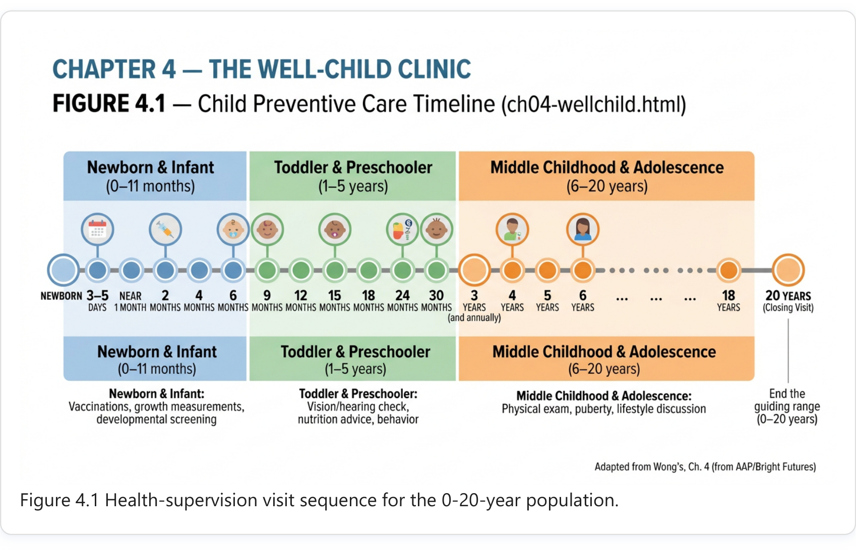
HUMAN GROWTH AND DEVELOPMENT
8.2 Physical Growth During Puberty
Source page 2 of 7 (continued)
Figure 8.1 places the pubertal events described above on a single timeline: peak height velocity
at about 12 years in girls and 14 years in boys, the menarche band, and the growth-spurt details
for each sex.
Adolescent Assessment
6
Notes:
8.2 Physical Growth During Puberty
The final 20% to 25% of linear growth is achieved during puberty, and up to 50% of ideal adult
body weight is gained during this time.
Girls begin puberty and reach maturity about 1½ to 2 years earlier than boys; the pubertal growth
spurt begins as early as 9½ or as late as 14½ years in girls, and as early as 10½ and as late as 16
years in boys.
The growth spurt reaches its peak at about 12 years in girls and about 14 years in boys.
Peak height velocity (PHV) occurs at about 12 years of age in girls, around 6 to 12 months before
menarche; PHV is used as a predictor of menarche, and height at menarche predicts ultimate adult
height. Few girls grow more than 5 cm (2 inches) after menarche; growth in girls' height usually
ceases 2 to 2½ years after menarche.
Boys typically reach PHV at about 14 years, after growth of the testicles and penis and appearance of
axillary and mature pubic hair; growth in height ceases at 18 or 20 years.
Peak weight velocity occurs about 6 months after PHV in girls (and about 6 months after menarche);
in boys the weight and height spurts occur simultaneously.
Leg-length increase precedes trunk growth by about 6 to 9 months and shoulders/chest by about 1
year: "outgrow shoes first, then pants, then shirts".
Body composition: girls' fat mass increases markedly in early puberty and continues to increase after
menarche; boys have a peak deceleration in fat-mass accumulation at the growth spurt, with
significantly higher lean body mass overall.
On average, girls gain 5-20 cm (2-8 inches) in height and 7-25 kg (15.5-55 lb) in weight during
adolescence. In the U.S., onset of Tanner stage 2 genital development in boys (mean): non-Hispanic
white 10.14 yr, African-American 9.14 yr, Hispanic 10.04 yr.
Figure 8.1 places the pubertal events described above on a single timeline: peak height velocity
at about 12 years in girls and 14 years in boys, the menarche band, and the growth-spurt details
for each sex.

Slide 8
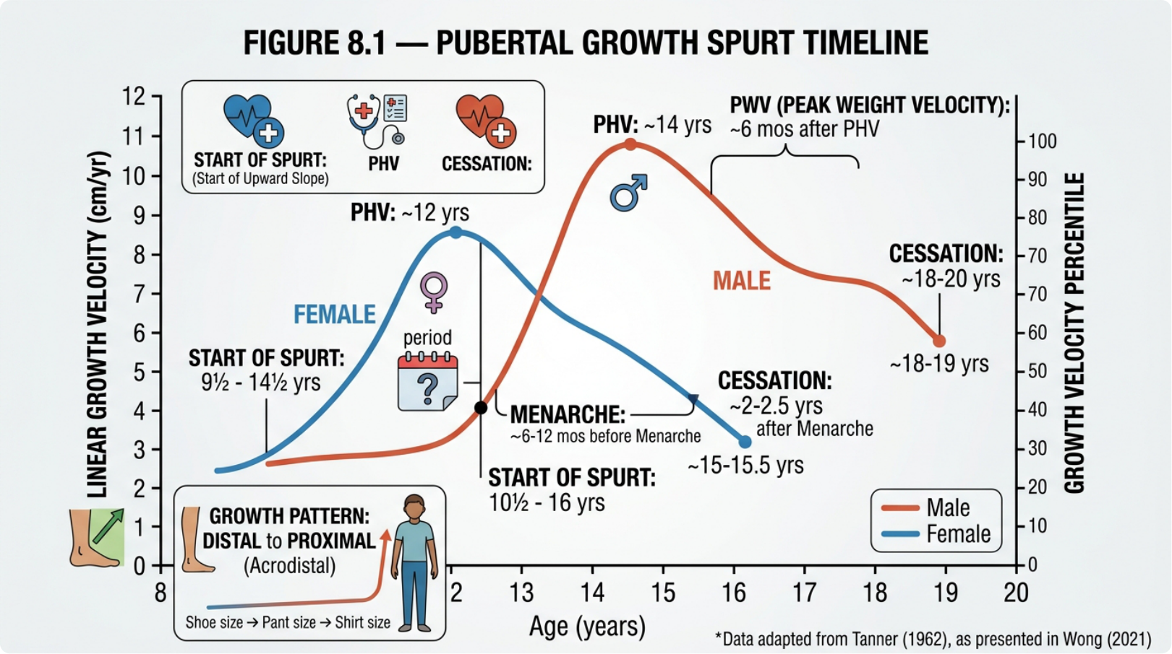
HUMAN GROWTH AND DEVELOPMENT
8.3 Sexual Maturation — Tanner Staging
Source page 3 of 7
Figure 8.1 Timeline of the pubertal growth spurt in girls and boys.
Adolescent Assessment
7
Notes:
Figure 8.1 Timeline of the pubertal growth spurt in girls and boys.
8.3 Sexual Maturation — Tanner Staging
Tanner stages describe pubertal development in numbered stages; in females they describe
development based on breast size and the shape and distribution of pubic hair, in males on
genital development and pubic hair; stage 1 = prepubertal, stage 5 = adult.
Example entries (boys): Stage 1 (prepubertal): no pubic hair — essentially the same as during
childhood, no distinction between hair on the pubis and over the abdomen. Stage 4: increased size of
the penis with growth in diameter and development of the glans; glans larger and broader; scrotum
darker; pubic hair more abundant with curling.
Fertility: from a clinical perspective an adolescent should be considered potentially fertile with a first
menstrual period or a first ejaculation; viable sperm production tends to follow the first ejaculation by
about 1 year.
Boys do not experience a discrete event analogous to menstruation; the capacity to ejaculate appears
approximately 1 year after initial testicular enlargement and the appearance of pubic hair.

Slide 9
HUMAN GROWTH AND DEVELOPMENT
8.3 Sexual Maturation — Tanner Staging
Source page 3 of 7 (continued)
Tanner stages describe pubertal development in numbered stages; in females they describe
development based on breast size and the shape and distribution of pubic hair, in males on
genital development and pubic hair; stage 1 = prepubertal, stage 5 = adult.
Example entries (boys): Stage 1 (prepubertal): no pubic hair — essentially the same as during
childhood, no distinction between hair on the pubis and over the abdomen. Stage 4: increased size of
the penis with growth in diameter and development of the glans; glans larger and broader; scrotum
darker; pubic hair more abundant with curling.
Fertility: from a clinical perspective an adolescent should be considered potentially fertile with a first
menstrual period or a first ejaculation; viable sperm production tends to follow the first ejaculation by
about 1 year.
Boys do not experience a discrete event analogous to menstruation; the capacity to ejaculate appears
approximately 1 year after initial testicular enlargement and the appearance of pubic hair.
Adolescent Assessment
8
Notes:
Figure 8.1 Timeline of the pubertal growth spurt in girls and boys.
8.3 Sexual Maturation — Tanner Staging
Tanner stages describe pubertal development in numbered stages; in females they describe
development based on breast size and the shape and distribution of pubic hair, in males on
genital development and pubic hair; stage 1 = prepubertal, stage 5 = adult.
Example entries (boys): Stage 1 (prepubertal): no pubic hair — essentially the same as during
childhood, no distinction between hair on the pubis and over the abdomen. Stage 4: increased size of
the penis with growth in diameter and development of the glans; glans larger and broader; scrotum
darker; pubic hair more abundant with curling.
Fertility: from a clinical perspective an adolescent should be considered potentially fertile with a first
menstrual period or a first ejaculation; viable sperm production tends to follow the first ejaculation by
about 1 year.
Boys do not experience a discrete event analogous to menstruation; the capacity to ejaculate appears
approximately 1 year after initial testicular enlargement and the appearance of pubic hair.

Slide 10
HUMAN GROWTH AND DEVELOPMENT
8.4 Nutrition in Adolescence
Source page 4 of 7
The full breast-and-pubic-hair staging tables are not reproduced here; consult your course's printed
staging charts for the complete figures while practising the examination.
Point | Practice implication
Puberty can double nutritional requirements for iron, calcium, zinc, and protein | Assess intake at every visit; high-need foods first (dairy, protein, whole grains, fruits, vegetables)
Girls are particularly susceptible to iron deficiency at Screen dietary iron; anemia signs; encourage menarche iron-rich foods with vitamin C
Maximum bone mass is acquired during adolescence; calcium deposited now determines later osteoporosis risk | Encourage calcium-rich intake; discourage dietary substitutes that displace dairy
Common pattern: excess calories, sugar, fat, cholesterol, Teach balanced food choices (as in the school- sodium; inadequate folic acid, vitamin B6, vitamin A, iron, age nutrition section); watch fast-food and soft- calcium, zinc — especially girls and low-SES teens drink displacement
Weight-conscious behavior and overweight have increased among adolescents | Plot growth on CDC charts; discuss weight status without body shaming
8.5 Body Image & Eating Disorders
Adolescent Assessment
9
Notes:
The full breast-and-pubic-hair staging tables are not reproduced here; consult your course's printed
staging charts for the complete figures while practising the examination.
8.4 Nutrition in Adolescence
Point
Practice implication
Puberty can double nutritional requirements for iron,
calcium, zinc, and protein
Assess intake at every visit; high-need foods
first (dairy, protein, whole grains, fruits,
vegetables)
Girls are particularly susceptible to iron deficiency at
menarche
Screen dietary iron; anemia signs; encourage
iron-rich foods with vitamin C
Maximum bone mass is acquired during adolescence;
calcium deposited now determines later osteoporosis risk
Encourage calcium-rich intake; discourage
dietary substitutes that displace dairy
Common pattern: excess calories, sugar, fat, cholesterol,
sodium; inadequate folic acid, vitamin B6, vitamin A, iron,
calcium, zinc — especially girls and low-SES teens
Teach balanced food choices (as in the school-
age nutrition section); watch fast-food and soft-
drink displacement
Weight-conscious behavior and overweight have
increased among adolescents
Plot growth on CDC charts; discuss weight
status without body shaming
8.5 Body Image & Eating Disorders
Body image is important for adolescent girls; a common behaviour is extensive dieting at a time
when physical changes are occurring, and a focus on slimness and dieting may trigger the
development of eating disorders.
Anorexia nervosa and bulimia nervosa occur among adolescents; screen with non-judgmental
questions about meal patterns, dieting behaviour, and weight concerns.
Body image and gender-role definition are nearly secured by late adolescence; identity consolidates.
Acne and feelings of sadness or depression are among the health concerns adolescents report.
This guide covers the detection and referral signals for eating disorders; diagnosis and treatment
follow specialist protocols.

Slide 11
HUMAN GROWTH AND DEVELOPMENT
8.4 Nutrition in Adolescence
Source page 4 of 7 (continued)
Body image is important for adolescent girls; a common behaviour is extensive dieting at a time
when physical changes are occurring, and a focus on slimness and dieting may trigger the
development of eating disorders.
Anorexia nervosa and bulimia nervosa occur among adolescents; screen with non-judgmental
questions about meal patterns, dieting behaviour, and weight concerns.
Body image and gender-role definition are nearly secured by late adolescence; identity consolidates.
Acne and feelings of sadness or depression are among the health concerns adolescents report.
This guide covers the detection and referral signals for eating disorders; diagnosis and treatment
follow specialist protocols.
Adolescent Assessment
10
Notes:
The full breast-and-pubic-hair staging tables are not reproduced here; consult your course's printed
staging charts for the complete figures while practising the examination.
8.4 Nutrition in Adolescence
Point
Practice implication
Puberty can double nutritional requirements for iron,
calcium, zinc, and protein
Assess intake at every visit; high-need foods
first (dairy, protein, whole grains, fruits,
vegetables)
Girls are particularly susceptible to iron deficiency at
menarche
Screen dietary iron; anemia signs; encourage
iron-rich foods with vitamin C
Maximum bone mass is acquired during adolescence;
calcium deposited now determines later osteoporosis risk
Encourage calcium-rich intake; discourage
dietary substitutes that displace dairy
Common pattern: excess calories, sugar, fat, cholesterol,
sodium; inadequate folic acid, vitamin B6, vitamin A, iron,
calcium, zinc — especially girls and low-SES teens
Teach balanced food choices (as in the school-
age nutrition section); watch fast-food and soft-
drink displacement
Weight-conscious behavior and overweight have
increased among adolescents
Plot growth on CDC charts; discuss weight
status without body shaming
8.5 Body Image & Eating Disorders
Body image is important for adolescent girls; a common behaviour is extensive dieting at a time
when physical changes are occurring, and a focus on slimness and dieting may trigger the
development of eating disorders.
Anorexia nervosa and bulimia nervosa occur among adolescents; screen with non-judgmental
questions about meal patterns, dieting behaviour, and weight concerns.
Body image and gender-role definition are nearly secured by late adolescence; identity consolidates.
Acne and feelings of sadness or depression are among the health concerns adolescents report.
This guide covers the detection and referral signals for eating disorders; diagnosis and treatment
follow specialist protocols.

Slide 12
HUMAN GROWTH AND DEVELOPMENT
8.6 Injury Prevention & Safety
Source page 5 of 7
Injuries kill more U.S. adolescents than any other single cause; unintentional injury accounted for
48% of deaths among 12-19-year-olds (1996-2005), and its share rose with age.
Motor-vehicle crashes are the single greatest source of unintentional injury and death in young
people; contributory factors: lacking driving experience and maturity, following too closely, speeding,
other teen passengers in the car, alcohol use.
Homicide is the second leading cause of death among all U.S. adolescents and the most likely cause
for African-American teenagers; in 2007, 82% of homicides among 13-19-year-olds were firearm-
related.
In 2011, 5.1% of adolescents nationwide reported carrying a weapon on one or more days in the past
month (down from 27% in 1991); teens targeted for repeated teasing/harassment are more likely to
skip school, report depression symptoms, attempt suicide, and bring weapons to school.
Sports: participation physical examinations at least every 2 years; teach and model helmet use for
cycling, skating, and helmeted sports (a helmet reduces head injury ~45% and brain injury ~33%).
Cover injury-prevention counseling at every visit per the Bright Futures "violence and injury
prevention" item.
8.7 Adolescent Immunizations & Special Screens
Adolescent Assessment
11
Notes:
8.6 Injury Prevention & Safety
Injuries kill more U.S. adolescents than any other single cause; unintentional injury accounted for
48% of deaths among 12-19-year-olds (1996-2005), and its share rose with age.
Motor-vehicle crashes are the single greatest source of unintentional injury and death in young
people; contributory factors: lacking driving experience and maturity, following too closely, speeding,
other teen passengers in the car, alcohol use.
Homicide is the second leading cause of death among all U.S. adolescents and the most likely cause
for African-American teenagers; in 2007, 82% of homicides among 13-19-year-olds were firearm-
related.
In 2011, 5.1% of adolescents nationwide reported carrying a weapon on one or more days in the past
month (down from 27% in 1991); teens targeted for repeated teasing/harassment are more likely to
skip school, report depression symptoms, attempt suicide, and bring weapons to school.
Sports: participation physical examinations at least every 2 years; teach and model helmet use for
cycling, skating, and helmeted sports (a helmet reduces head injury ~45% and brain injury ~33%).
Cover injury-prevention counseling at every visit per the Bright Futures "violence and injury
prevention" item.
8.7 Adolescent Immunizations & Special Screens
Vaccine / screen
Recommendation
Meningococcal
(MenACWY)
Adolescents 11-12 years with a booster dose before age 16; if not previously
vaccinated, one dose between 13 and 18 years
HPV
9-valent vaccine (Gardasil 9) for girls and boys; routine at 11-12 years with a
minimum age of 9; two doses if the series starts at 9-14 years, three doses if it starts
at 15 years or later or in immunocompromised persons
Hepatitis B
Catch-up for any adolescent who has not received three doses
Hepatitis A
Targeted — adolescents living where programs target older children, at increased
risk, or when immunity is desired
Influenza
Annual vaccination (live attenuated or inactivated) for all children and adolescents

Slide 13
HUMAN GROWTH AND DEVELOPMENT
8.6 Injury Prevention & Safety
Source page 5 of 7 (continued)
Vaccine / screen | Recommendation
Meningococcal (MenACWY) | Adolescents 11-12 years with a booster dose before age 16; if not previously vaccinated, one dose between 13 and 18 years
HPV 9-valent vaccine (Gardasil 9) for girls and boys; routine at 11-12 years with a minimum age of 9; two doses if the series starts at 9-14 years, three doses if it starts at 15 years or later or in immunocompromised persons
Hepatitis B | Catch-up for any adolescent who has not received three doses
Hepatitis A Targeted — adolescents living where programs target older children, at increased risk, or when immunity is desired
Influenza | Annual vaccination (live attenuated or inactivated) for all children and adolescents
Adolescent Assessment
12
Notes:
8.6 Injury Prevention & Safety
Injuries kill more U.S. adolescents than any other single cause; unintentional injury accounted for
48% of deaths among 12-19-year-olds (1996-2005), and its share rose with age.
Motor-vehicle crashes are the single greatest source of unintentional injury and death in young
people; contributory factors: lacking driving experience and maturity, following too closely, speeding,
other teen passengers in the car, alcohol use.
Homicide is the second leading cause of death among all U.S. adolescents and the most likely cause
for African-American teenagers; in 2007, 82% of homicides among 13-19-year-olds were firearm-
related.
In 2011, 5.1% of adolescents nationwide reported carrying a weapon on one or more days in the past
month (down from 27% in 1991); teens targeted for repeated teasing/harassment are more likely to
skip school, report depression symptoms, attempt suicide, and bring weapons to school.
Sports: participation physical examinations at least every 2 years; teach and model helmet use for
cycling, skating, and helmeted sports (a helmet reduces head injury ~45% and brain injury ~33%).
Cover injury-prevention counseling at every visit per the Bright Futures "violence and injury
prevention" item.
8.7 Adolescent Immunizations & Special Screens
Vaccine / screen
Recommendation
Meningococcal
(MenACWY)
Adolescents 11-12 years with a booster dose before age 16; if not previously
vaccinated, one dose between 13 and 18 years
HPV
9-valent vaccine (Gardasil 9) for girls and boys; routine at 11-12 years with a
minimum age of 9; two doses if the series starts at 9-14 years, three doses if it starts
at 15 years or later or in immunocompromised persons
Hepatitis B
Catch-up for any adolescent who has not received three doses
Hepatitis A
Targeted — adolescents living where programs target older children, at increased
risk, or when immunity is desired
Influenza
Annual vaccination (live attenuated or inactivated) for all children and adolescents

Slide 14
HUMAN GROWTH AND DEVELOPMENT
8.8 Psychosocial Assessment & Health Education
Source page 6 of 7
Varicella Assess history; vaccinate those with no previous infection/history — two doses ≥4 weeks apart for adolescents 13 years or older Tuberculin skin test If exposed to active TB, lived in a homeless shelter, incarcerated, from/came from a high-prevalence TB area, or currently work in a health care setting Blood pressure BP rises from the onset of adolescence until the end of pubertal growth, especially in males; ~1% of adolescents have sustained hypertension — measure annually and use the appropriate-size cuff
 | The adolescent schedule changes from time to time — verify the ages above against the current official printed schedule when you chart. The scoliosis and vision/hearing methods from Chapters 4 and 7 continue to apply in the adolescent clinic.
Varicella Assess history; vaccinate those with no previous infection/history — two doses ≥4 weeks apart for adolescents 13 years or older
Tuberculin skin test | If exposed to active TB, lived in a homeless shelter, incarcerated, from/came from a high-prevalence TB area, or currently work in a health care setting
Blood pressure BP rises from the onset of adolescence until the end of pubertal growth, especially in males; ~1% of adolescents have sustained hypertension — measure annually and use the appropriate-size cuff
INTERVIEW DOMAINS
Adolescent Assessment
13
Notes:
Varicella
Assess history; vaccinate those with no previous infection/history — two doses ≥4
weeks apart for adolescents 13 years or older
Tuberculin skin test
If exposed to active TB, lived in a homeless shelter, incarcerated, from/came from a
high-prevalence TB area, or currently work in a health care setting
Blood pressure
BP rises from the onset of adolescence until the end of pubertal growth, especially in
males; ~1% of adolescents have sustained hypertension — measure annually and use
the appropriate-size cuff
The adolescent schedule changes from time to time — verify the ages above against the current
official printed schedule when you chart. The scoliosis and vision/hearing methods from Chapters 4
and 7 continue to apply in the adolescent clinic.
8.8 Psychosocial Assessment & Health Education
INTERVIEW DOMAINS
School: recent grades, absences, suspensions, repeated grades; school-related strengths and
deficits; involvement in activities.
Peers: quality of peer relationships — may identify socially isolated teens.
Future plans: education/employment and career choices — a window into sources of stress.
Strengths: teach coping-with-stress skills and involvement in personally meaningful activities to
support emotional health.
Emotional well-being: sadness, depression, suicidal ideation; adolescents whose personal fable
stresses their uniqueness are at higher risk for depression and suicidal ideation, while a strong sense
of invulnerability predicts risky behaviour.
Risk behaviours: below-average grades correlate with tobacco/alcohol use, unprotected
intercourse, and suicide attempts; violence and harassment on the basis of race, gender, or sexual
orientation affect more than half of students.
These domains are commonly memorised with the HEEADSSS mnemonic used in adolescent teaching
materials — Home, Education, Eating, Activities, Drugs, Sexuality, Suicide-depression, Safety — and every
question it prompts maps to the content here.

Slide 15
HUMAN GROWTH AND DEVELOPMENT
8.8 Psychosocial Assessment & Health Education
Source page 6 of 7 (continued)
School: recent grades, absences, suspensions, repeated grades; school-related strengths and
deficits; involvement in activities.
Peers: quality of peer relationships — may identify socially isolated teens.
Future plans: education/employment and career choices — a window into sources of stress.
Strengths: teach coping-with-stress skills and involvement in personally meaningful activities to
support emotional health.
Emotional well-being: sadness, depression, suicidal ideation; adolescents whose personal fable
stresses their uniqueness are at higher risk for depression and suicidal ideation, while a strong sense
of invulnerability predicts risky behaviour.
Risk behaviours: below-average grades correlate with tobacco/alcohol use, unprotected
intercourse, and suicide attempts; violence and harassment on the basis of race, gender, or sexual
orientation affect more than half of students.
These domains are commonly memorised with the HEEADSSS mnemonic used in adolescent teaching
materials — Home, Education, Eating, Activities, Drugs, Sexuality, Suicide-depression, Safety — and every
question it prompts maps to the content here.
Adolescent Assessment
14
Notes:
Varicella
Assess history; vaccinate those with no previous infection/history — two doses ≥4
weeks apart for adolescents 13 years or older
Tuberculin skin test
If exposed to active TB, lived in a homeless shelter, incarcerated, from/came from a
high-prevalence TB area, or currently work in a health care setting
Blood pressure
BP rises from the onset of adolescence until the end of pubertal growth, especially in
males; ~1% of adolescents have sustained hypertension — measure annually and use
the appropriate-size cuff
The adolescent schedule changes from time to time — verify the ages above against the current
official printed schedule when you chart. The scoliosis and vision/hearing methods from Chapters 4
and 7 continue to apply in the adolescent clinic.
8.8 Psychosocial Assessment & Health Education
INTERVIEW DOMAINS
School: recent grades, absences, suspensions, repeated grades; school-related strengths and
deficits; involvement in activities.
Peers: quality of peer relationships — may identify socially isolated teens.
Future plans: education/employment and career choices — a window into sources of stress.
Strengths: teach coping-with-stress skills and involvement in personally meaningful activities to
support emotional health.
Emotional well-being: sadness, depression, suicidal ideation; adolescents whose personal fable
stresses their uniqueness are at higher risk for depression and suicidal ideation, while a strong sense
of invulnerability predicts risky behaviour.
Risk behaviours: below-average grades correlate with tobacco/alcohol use, unprotected
intercourse, and suicide attempts; violence and harassment on the basis of race, gender, or sexual
orientation affect more than half of students.
These domains are commonly memorised with the HEEADSSS mnemonic used in adolescent teaching
materials — Home, Education, Eating, Activities, Drugs, Sexuality, Suicide-depression, Safety — and every
question it prompts maps to the content here.

Slide 16
HUMAN GROWTH AND DEVELOPMENT
Adolescent Assessment
Source page 7 of 7
Chapter 8 Learning Check
Self-assessment questions (answer in your notebook, then open)
End of Chapter 8.
Adolescent Assessment
15
Notes:
Chapter 8 Learning Check
Self-assessment questions (answer in your notebook, then open)
End of Chapter 8.

Slide 17
Document Information
Adolescent Assessment
تقييم المراهق (Adolescent Assessment)
Source file: Chapter 8 — Adolescent Assessment.pdf
Pages in source: 7
Slides in this deck: 17
Course: Human Growth and Development — Practical Lectures
Full readable text and the original file are available on the lecture platform:
https://moustafaali-prog.github.io/growth-development-lectures/lectures/practical/Chapter 8 — Adolescent Assessment.html
Notes:
Closing slide. Content reproduced verbatim from Chapter 8 — Adolescent Assessment.pdf.

